Slide 1
Electric Circuits
Chapter 3

Slide 2
Resistive Circuits Overview
• Resistors in series
• Resistors in parallel
• Voltage dividers
• Current dividers
D’Arsonval meter movement
• Wye-Delta transformations

Slide 3
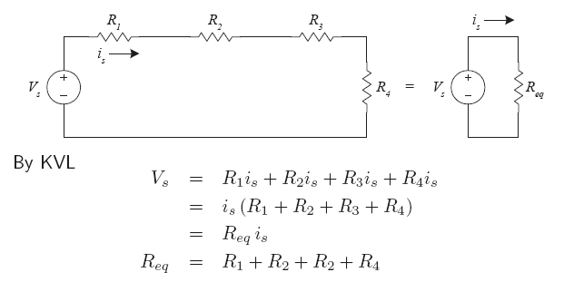
Resistors in Series
• Electrically, there is no difference between the two circuits
4 resistors can be replaced by Req.
Circuit elements connected in series carry the same current.
We apply KVL around the loop.
For the numerical value of Req, Resistors in series add
• Similar to voltage sources

Slide 4
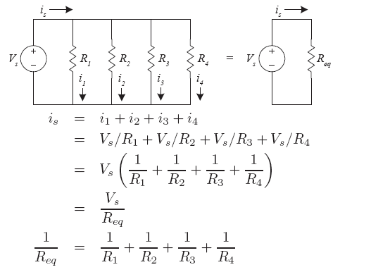
Resistors in Parallel
4 resistors in paralel can be replaced by a single resistor Req.
Let i1,i2,i3,and i4 be currents in R1 through R4, respectively.
Circuit elements connected in parallel have the same voltage across their terminals.

Slide 5
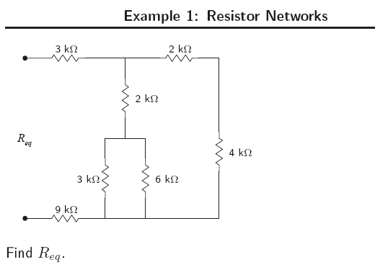

Slide 6
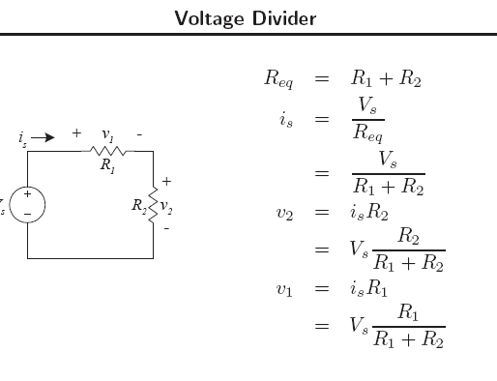
Sometimes developing more than one voltage level from a voltage supply is necessary. We do so by using voltage divider.

Slide 7
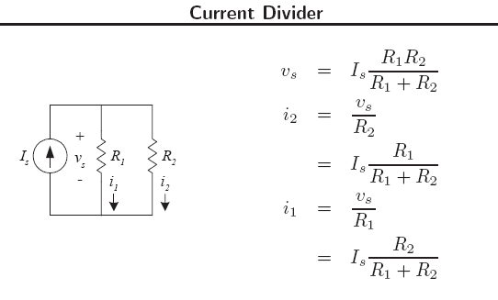
Current Divider
The current divider divides Is between R1 an R2
We find the relationship between Is and the current in each resistor

Slide 8
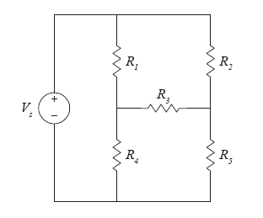
Resistor Networks: Comments
Knowing the equivalent and parallel equivalents of resistors is not
quite adequate
There are some configurations that require one more tool

Slide 9
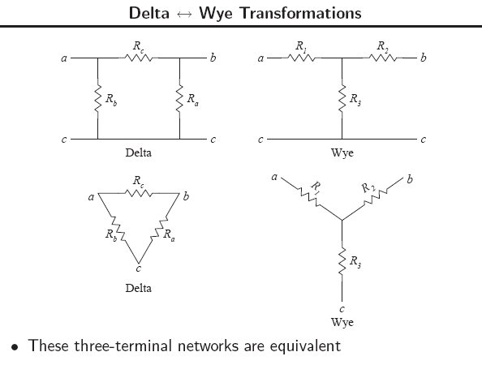

Slide 10
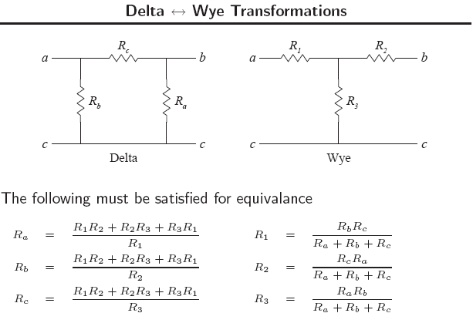

Slide 11
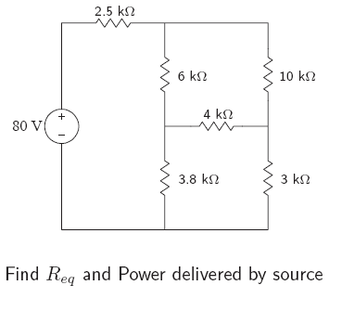
example

Slide 12
Wheatson Bridge

Slide 13
D’Arsonvalmeter

